Slide 1
Azure Functions

Slide 2
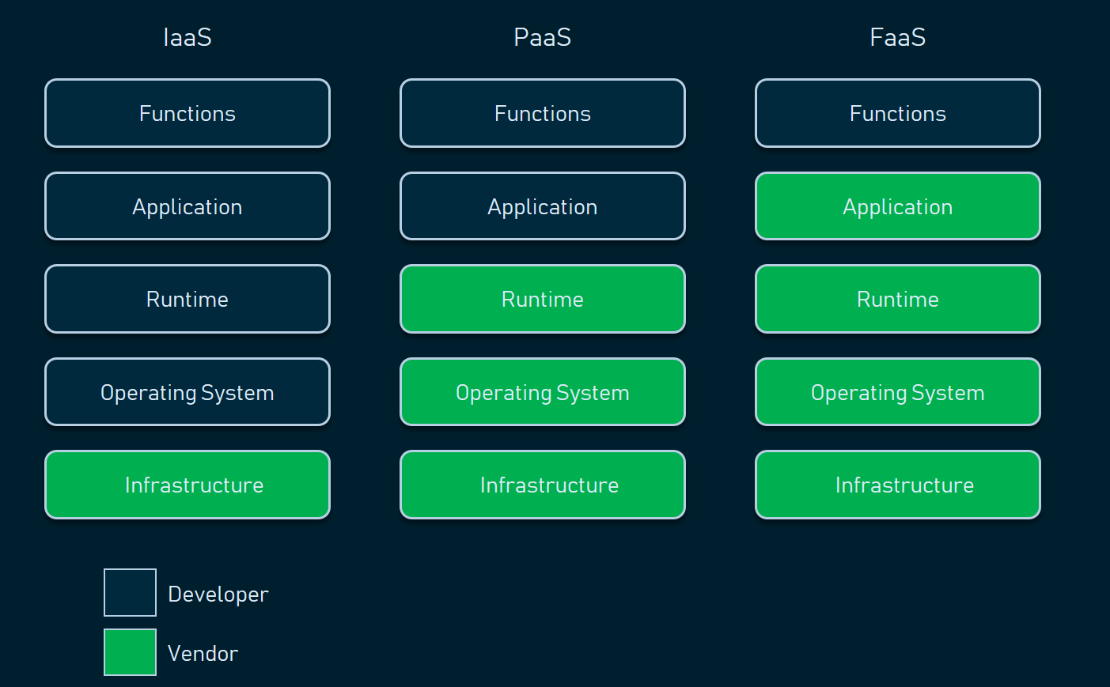
Backend as a Service

Slide 3
What is Serverless ?
Abstracted Infrastructure – Application and infrastructure is separated properly, and infrastructure is abstracted away from the developer.
Elasticity – Scales infinitely without manual configuration of any VM or K8s cluster.
Cost Efficient – You are only billed for active invocations.
Rapid development – Focus on code and not operations.
Stateless and Ephemeral – Holds no state.
Asynchronous event triggered – Triggered on some event.
Polyglot – Code can be written in Java, C#, Node.js, Python, PHP, etc.

Slide 4
Serverless advantages
Pay for only active invocations.
Highly scalable.
App and Infra separation.
Polyglot.
Good use of infrastructure (No unnecessary wastage of resources)
Reduced DevOps.
Reduced time to market

Slide 5
Serverless disadvantages
Stateless and Ephemeral.
Increased latency on cold boot.
Vendor lock-in (Migration to other cloud provider is difficult).
Integration testing is difficult.
Local debugging is difficult (Lots of special tools needed like emulators)
Not suitable for long running processes.
Not suitable for CPU/memory intensive operations.
Pricing can be unpredictable under heavy load.

Slide 6
Good Serverless Use-Cases
Scheduled tasks (CRON)
ETL operations
Image manipulations (Conversion, Compression, EXIF reading etc.)
PDF generation
JSON reshaping
XML reshaping
Simple backend systems
Sending emails
Sending SMS
Message queue consumers

Slide 7
Bad Serverless Use-Cases
Any blocking process.
Any time-consuming process.
Any process which needs large amounts of physical memory. (Because of upper bound of physical memory imposed).
Training complex models
Machine learning dataset.
Deep learning dataset with multiple epochs.

Slide 8
FaaS offerings in Public cloud
All major public cloud providers Amazon, Microsoft, and Google have their own offering of Serverless FaaS.
AWS Lambda – First ever FaaS launched, introduced in the year 2014 in AWS cloud.
Azure Functions – Introduced in the year 2016, a core service in the Azure cloud.
Google Cloud Functions – Introduced in late 2017 as part of GCP cloud.

Slide 9
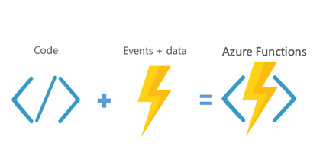
Azure Functions
Serverless compute service offered by Azure that enables you to write code without you to managing infrastructure.

Slide 10
Supported runtimes
C# - (.NET Core 3.1 and .NET 6)
Java – (8.0 and 11.0)
Node.js (Vanilla JS and Typescript) – 12 LTS, 14 LTS, 16 LTS
Python – (3.7, 3.8, 3.9)
Golang – Custom handlers
Rust – Custom handlers
PowerShell – PowerShell core

Slide 11
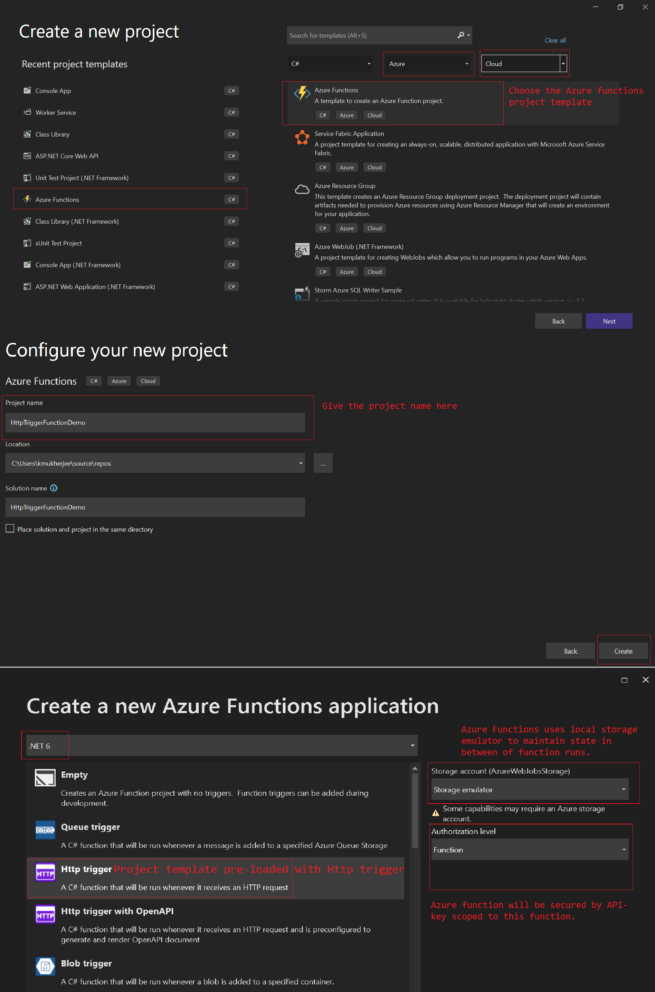
Azure Functions Visual Studio Template

Slide 12
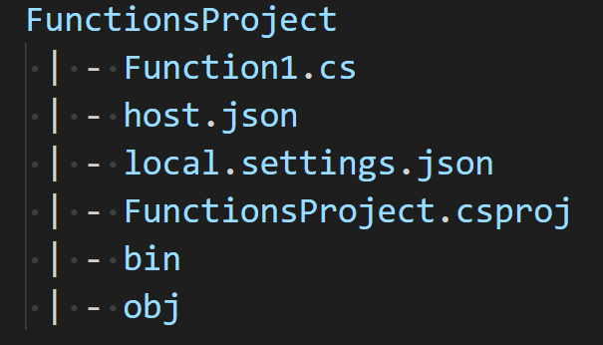
Azure Function File Structure
Function1.cs - Main class file that contains the Azure Function code.
host.json - JSON file containing all the settings or configuration options that affect all the Azure functions within that Azure function App.
local.settings.json - JSON file containing the application settings values from the Azure Portal which can be overridden and needed to debug locally for development.
.csproj – Is the file describing the what external dependencies the function app has and it also contains various other information telling how to build the function app project.

Slide 13
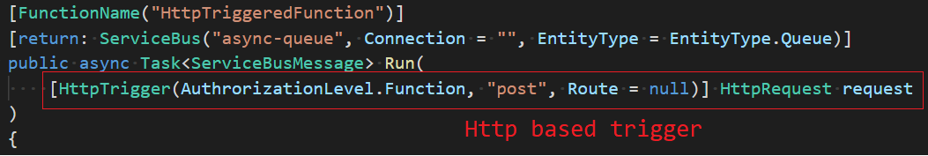
Triggers
Triggers are what cause a function to run. A trigger defines how a function is invoked.
An Azure function can only have a single trigger.
Triggers have associated data to them, which are provided to the function as parameters.
Azure functions supports many triggers – HTTP, Timer, IoT, Blob storage, Azure Storage queue, Azure Cosmos DB, RabbitMQ, Kafka, Azure Service Bus, SendGrid, Twilio, etc.

Slide 14
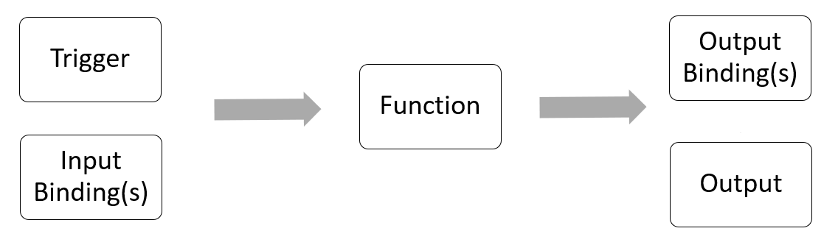
Bindings
Bindings are basically ways to connect to external services in Azure like post message to a queue, write files to blobs container. Bindings can reduce boilerplate code needed to achieve these tasks.
Binding can be of 2 types –
Input
Output
Data from bindings is provided to the function as parameters.

Slide 15
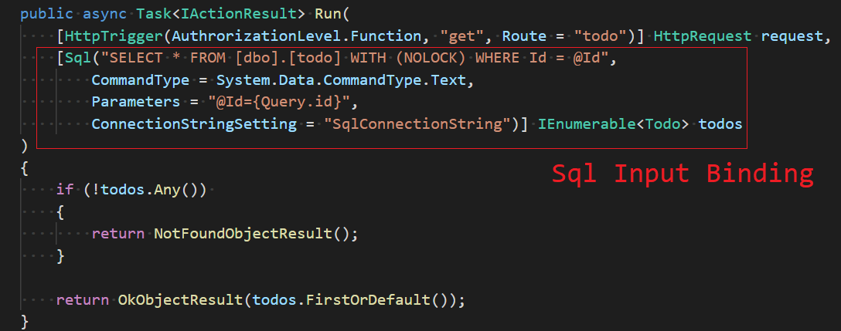
Input Bindings
Input bindings allows Azure functions to look up data from different input sources easily in a declarative way using Attributes in C#, without boilerplate code to access that service.
List of all supported input bindings can be seen here.

Slide 16
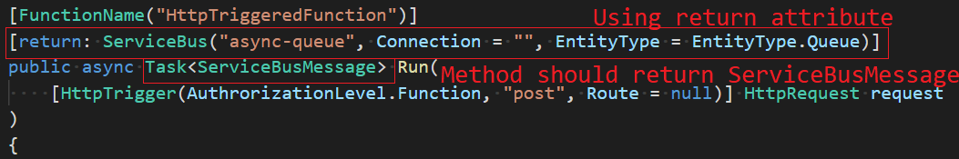
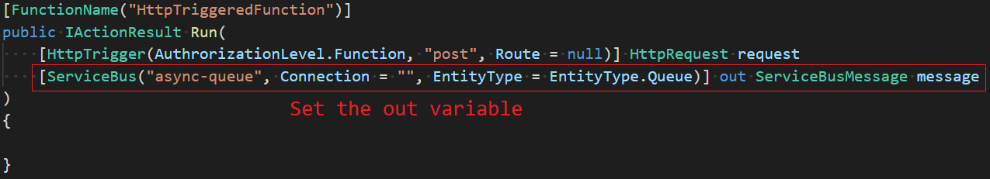
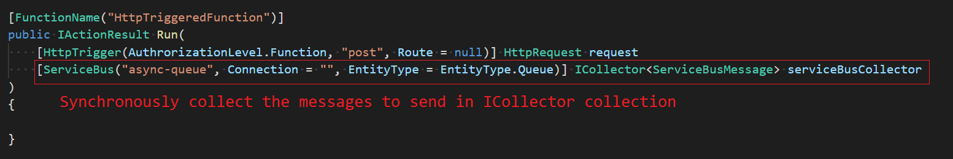
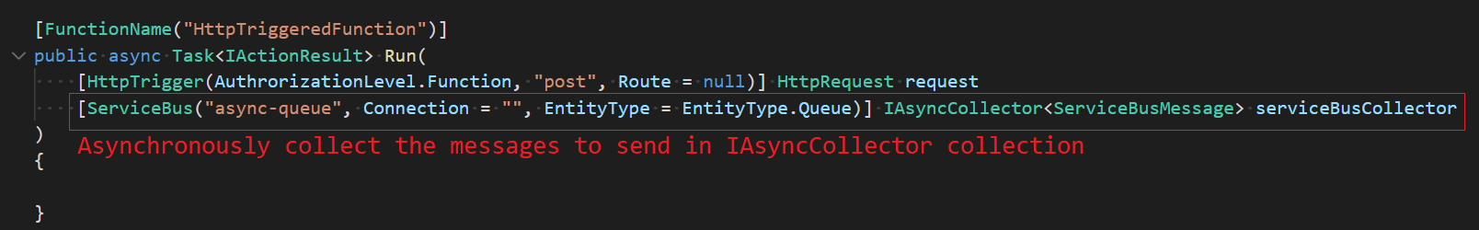
Output Bindings
Output Bindings allow Azure functions to send data to other services in a declarative way without boilerplate code to connect to that service.
List of all supported output bindings can be seen here.

Slide 17
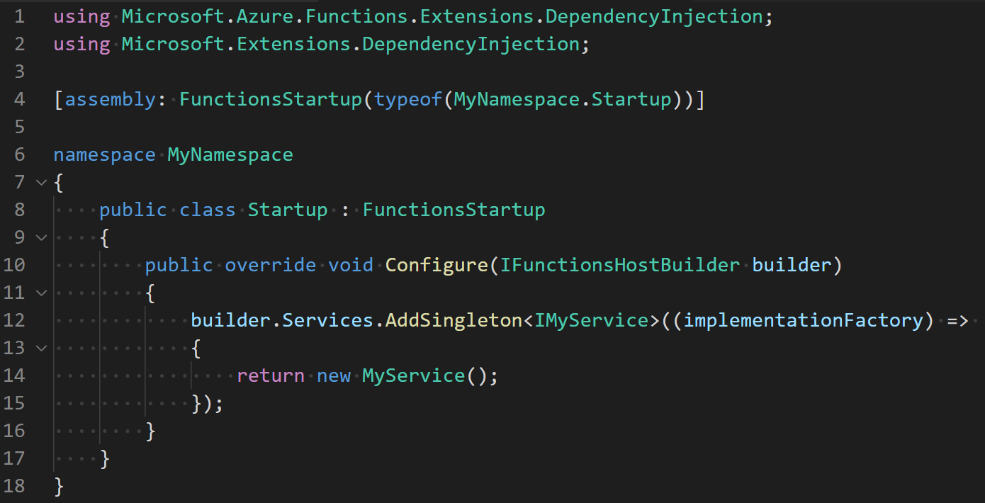
Dependency Injection
Install the nuget package - Microsoft.Azure.Functions.Extensions in your Azure function project.
Create a Startup.cs file in the root of your Azure Function project.
Decorate the Startup class with FunctionsStartup assembly attribute that specifies the type name used during startup.
Inherit your Startup class from FunctionsStartup class.
Override the Configure method and register your services in this method.

Slide 18
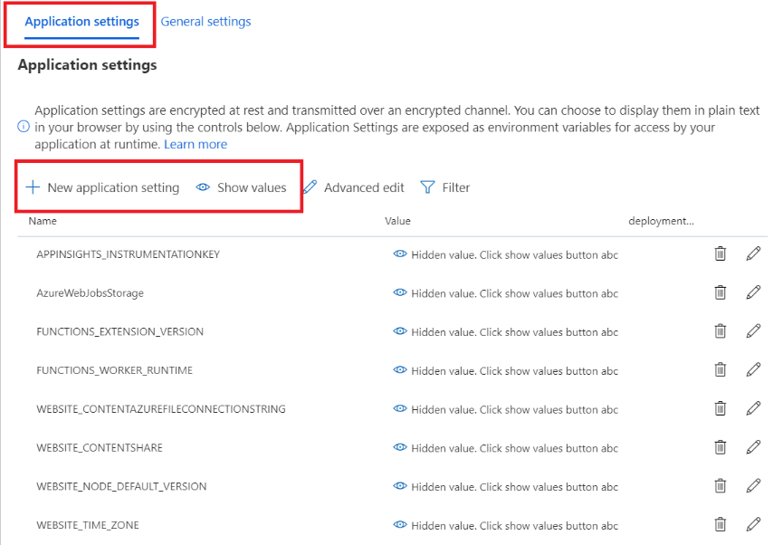
Configuration
Application settings are Azure defined or custom configurations required to run the Azure function app.
They will be injected as environment variables in our Azure function at runtime.
To debug locally/override some settings use the file – local.settings.json
It can be created from –
Azure Portal
AZ cli
PowerShell
Azure DevOps release pipeline

Slide 19
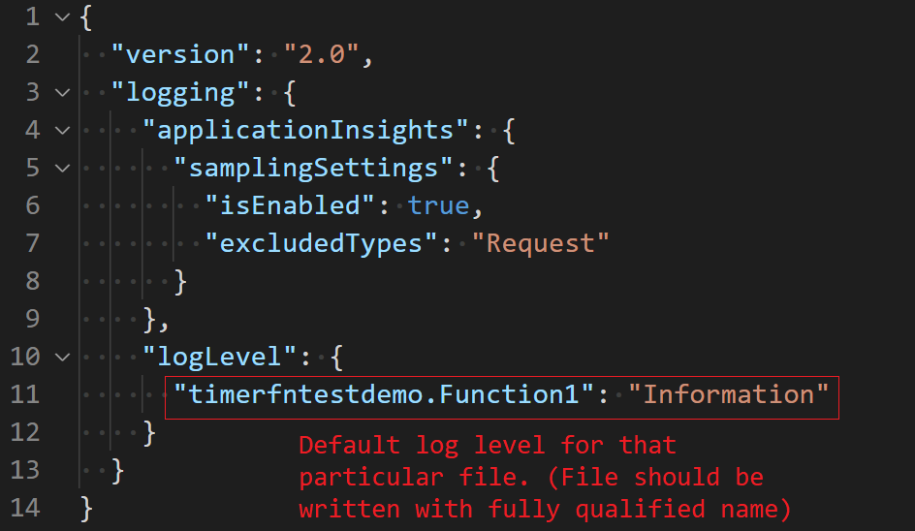
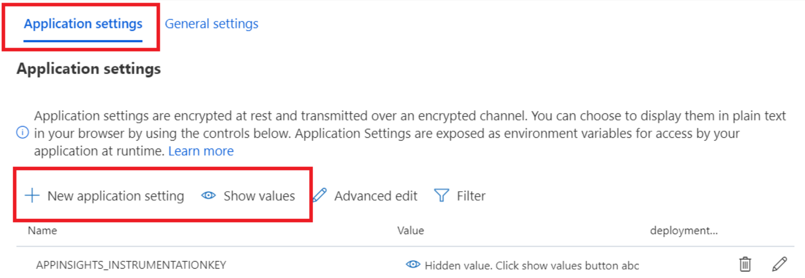
Logging
To create logs, we use the .NET core ILogger<TCategoryName> object from dependency injection.
The log level will be mentioned in the host.json file.
Azure functions when deployed provides native integration to Azure AppInsights.
Azure AppInsights need to enabled during/after function creation.
We can connect to Azure AppInsights using a valid instrumentation key.
Instrumentation key can be found in the Application settings blade in Azure portal.
Logs in Azure AppInsights are up to a certain limit is free which gets renewed daily, but if we exceed that limit Azure will charge accordingly.

Slide 20
Security
Azure functions can be secured using one of the following methods –
Authorization keys (HTTP triggered functions only)
Azure AD
Adding select hostnames in CORS header.
Using VNET in Premium Hosting plan.

Slide 21
Deployment
Azure functions can be deployed in a variety of ways –
Using publisher profile from within Visual Studio.
Using Azure DevOps CI-CD pipeline with Azure App service as hosting target.
Using Azure DevOps CI-CD pipeline with Azure Container Registry (ACR) as image source and Azure Kubernetes Service (AKS) as hosting target.

Slide 22
Pricing (Hosting Plan)
Azure Functions needs a GPv2 storage account to maintain the state of the function runs and hold some static assets also.
When we create our Azure function, we must choose from any one of the following hosting plans (More details here) –
Consumption Plan
Dedicated (App service) Plan
Premium Plan
The total running cost of the Azure function = Cost of running GPv2 storage account + Type of hosting plan (Consumption/App Service/Premium)

Slide 23
Consumption plan –
Memory usage can be between 128 MB – 1536 MB.
Default timeout is 5 minutes in this plan, the runtime will abruptly kill the function if it crosses that.
(Note: Its possible to extend the timeout to 10 minutes by adding functionTimeout in the host.json file)
Functions can “turn-off” after idling, when cold-starting again it can incur a startup cost.
Auto scaling is enabled based on the backpressure of the triggers.
Function app runtime can spin up to 200 instances under heavy load.
(E.g., while using Azure Service Bus, the runtime monitors the depth of the queue and determines if additional instances need to be provisioned)

Slide 24
Consumption plan uses a unit of resource consumption called GB-s.
The formula for calculating GB-s is -
1 GB-s = (number of executions) x (execution duration in seconds) x (amount of RAM used in GB)
Consumption plan gives a monthly free grant (renewing every month) of 400,000 GB-s and up to 1 million executions.
Execution times are rounded up to the nearest 100 milliseconds and RAM is rounded to the nearest 128 MB.
E.g. -
If function is using 234 MB memory it will be rounded to 256 MB (Nearest 128 MB).
If function is running 630 milliseconds it will be rounded to 700 Milliseconds (Nearest 100 milliseconds).

Slide 25
Case study Consumption Plan pricing (Monthly Production Values) -
Average Memory Consumption | 512 MB
Average Function Execution Duration | 500 milliseconds
Number of Executions | 2,000,000
Total GB-s (See formula prev slide) | 2,000,000 * 0.5 GB * 0.5 seconds | 500,000 GB-s
Monthly free grant |  | 400,000 GB-s
Billable GB-s (A) |  | 100,000 GB-s * $0.000016 per GB-s = $1.60
Total Executions |  | 2,000,000
Monthly free grant |  | 1,000,000
Billable executions (B) |  | 1,000,000 * $0.20 per million executions = $0.20
Total Cost (A + B) |  | $1.60 + $0.20 = $1.80

Slide 26
Dedicated (App service) Plan –
Uses existing or new App Service Plan. Prices based on the app service plan.
App service plan uses existing VM(s). VM(s) are charged upfront monthly (even if VM(s) are not fully utilized).
Function app is not constrained by 1536 MB memory limitation, it can grow till the limit which the App service plan supports.
No execution time limit theoretically, because CPU cores are provisioned for the underlying VM beforehand.
Functions can be “always-on”, which means no penalty for cold-starting.
One caveat is the scaling process is manual and not handled by Functions app runtime.
(Note: Auto scaling for App Service Plan is disabled by default, we can configure for example on average memory usage beyond a certain threshold (80%), the minimum and maximum number of VM(s) can be configured)

Slide 27
Premium plan –
Features | Description
Instance Size | Uses App Service Plan with Elastic Premium SKU(s) underneath. EP1 – 1 CPU Core – 3.5 GB Memory – 250 GB storage EP2 – 2 CPU Core – 7 GB Memory – 250 GB storage EP3 – 4 CPU Core – 14 GB Memory – 250 GB storage
Private networking | Native VNET integration
Scaling | Automatic Scaling In or Out based on load.
Scale Controls | Set minimum and maximum instances (Minimum is 1, Maximum is 100) (Note: Maximum scale out depends on the Azure Region. If OS is Windows, then the maximum is 100, else its up to 60 for Linux. See here for more details)
Warmup time (Cold start) | No delay after function app is inactive, scales instantly to pre-warmed instances. (Note: Default – 1, Maximum – 20 Pre warmed instances can be configured)
Timeout | Default is 30 minutes, can be increased up to 60 minutes using host.json setting.
Billing | Based on CPU core seconds and memory allocated across all instances. (Note: No executions charge like Consumption plan)

Slide 28
HTTP Trigger
Responds to a HTTP based trigger. Uses the HttpTrigger attribute to configure the settings.
We need to set the HTTP verb in the HttpTrigger attribute.
(Note: If not set by default if the HTTP verb is unspecified the runtime will invoke the function for any HTTP verb)
The request payload cannot exceed more than 100 MB in size.
If the function doesn’t return a response within 230 seconds the Azure Load Balancer will time out and return a HTTP 502 .
(Note: function will be running in background but won’t be able to return a HTTP response gracefully)

Slide 29
HTTP triggered Azure functions can be secured using Authorization keys.
The key can be passed as a query parameter (code) or in the headers (x-functions-key)the key will be validated by the Azure Function runtime.
There are 2 types of keys –
Admin/Host keys: These keys are shared for all functions inside an Azure function instance and can be used to authenticate any function.
Function keys: These keys are used to authenticate a single function inside an Azure function instance which has the configured level function.

Slide 30
Authorization keys are stateless and don’t contain anything about the caller.
These keys are good for machine-to-machine communication and not for public facing API(s).
Since they are static, we need to transfer them securely (Mails, Private chats, etc.)
Key Management can be “hard” if we have a lot of clients and functions.

Slide 31
HTTP trigger demo

Slide 32
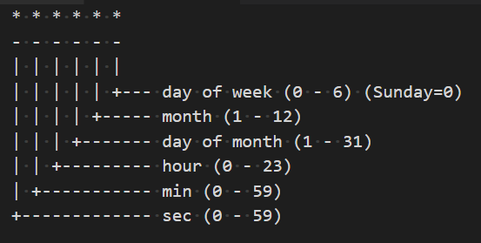
Timer Trigger
The Azure function is triggered on a schedule using the TimerTrigger attribute.
Azure functions uses NCronTab library to parse CRON schedules. It introduces an extra 6th field for additional precision in seconds.
The format of the NCronTab CRON schedule is as follows –
{second} {minute} {hour} {day} {month} {day-of-week}

Slide 33
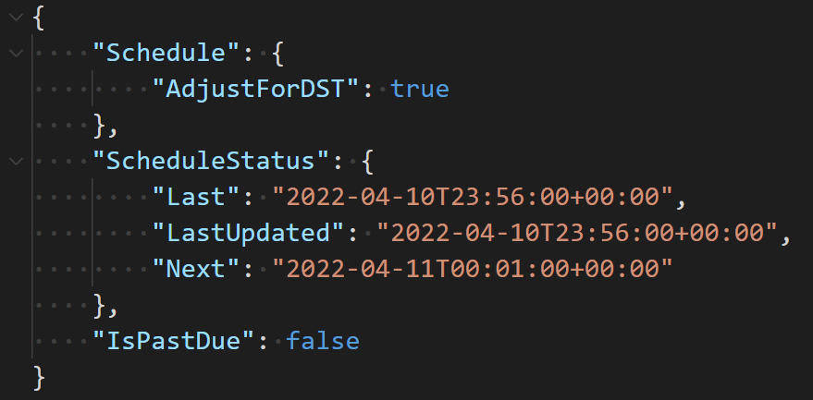
When the Azure function with timer trigger is invoked, it instantiates an TimerInfo object.
The TimerInfo object has ScheduleStatus property as null for duration less than 1 minute.
The IsPastDue will be set to true if the function invocation is later than the ScheduleStatus.Next property.

Slide 34
Timer trigger demo

Slide 35
Azure Service Bus Trigger
Processes the message using the ServiceBusTrigger attribute.
The received trigger parameter can be of any of one of the following types –
string – For simple text messages
byte[] – For binary data messages
POCO – The function runtime tries to deserialize a JSON object
ServiceBusReceivedMessage

Slide 36
Azure Service Bus trigger demo

Slide 37
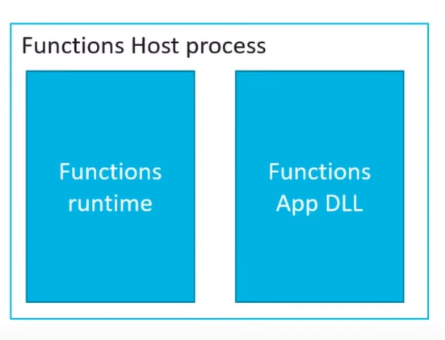
In-Process Mode
Traditionally Azure Functions in C# run in the in-process mode.
Request parameters are passed in memory and there is no proxying, because it’s the same process.
Any assemblies or 3rd party libraries must match the Azure function host runtime .NET version.

Slide 38
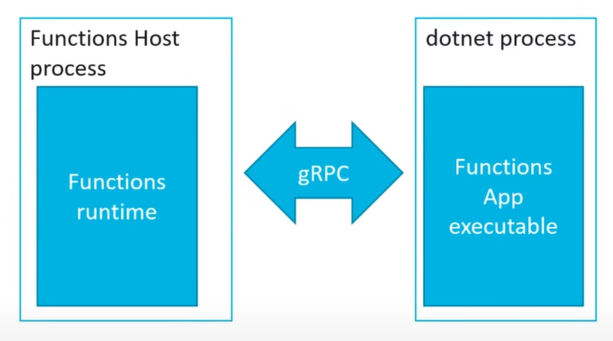
Isolated mode
Isolated model introduced in .NET 5
App runs in separate process from Azure function host runtime.
gRPC is used internally for communication.
Application can have different .NET version than the Azure function host runtime .NET version.
Support for Middlewares and dependency injection same as ASP .NET core.

Slide 39
Isolated mode demo

Slide 40
Microservices design patterns
We can solve a lot of common microservices problems using Azure functions using the following design patterns.
Request – Reply pattern
Claim – Check pattern
Competing Consumers pattern

Slide 41
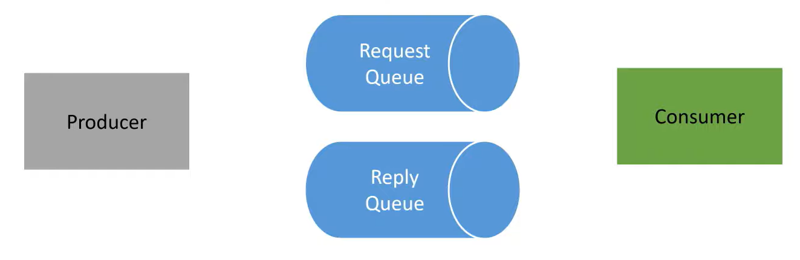
Request – Reply Pattern
Context and Problem –
Long running process can hamper the response time of the HTTP request.
How to move long running process out of the HTTP request context ?
Solution –
Producer application sets the ReplyTo property in the message and sends message to request queue.
Consumer processes the message and sends the acknowledgement back to reply queue after reading the ReplyTo property in the message.

Slide 42
Request Reply pattern demo

Slide 43
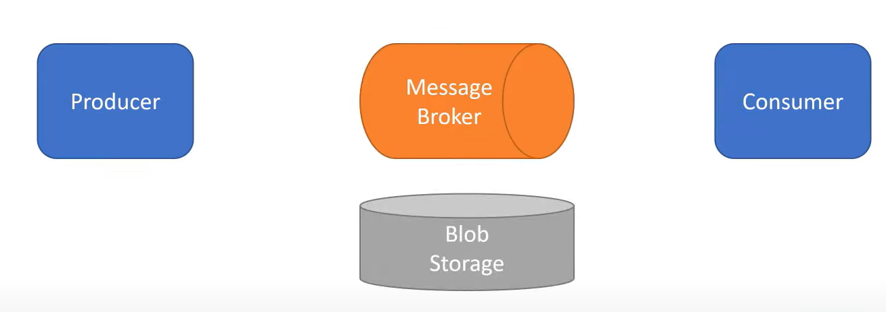
Claim Check pattern
Context and Problem –
Most messaging services have a hard limit on the message payload size.
(E.g., Azure Service Bus has hard limit of 256 KB (Basic/Standard) and 1 MB (Premium)
How to send large payloads like Images/Audio/Video over queues / topics ?
Solution –
Splitting the large payload into a claim check and payload.
Producer application uploads the large payload in any Blob storage (Azure Blob Storage / AWS S3), it gets the blob container reference (Claim check). It posts this blob container reference as the message payload body.
Consumer downloads the message by using the blob container reference (Claim check) and processes it accordingly.

Slide 44
Claim check pattern demo

Slide 45
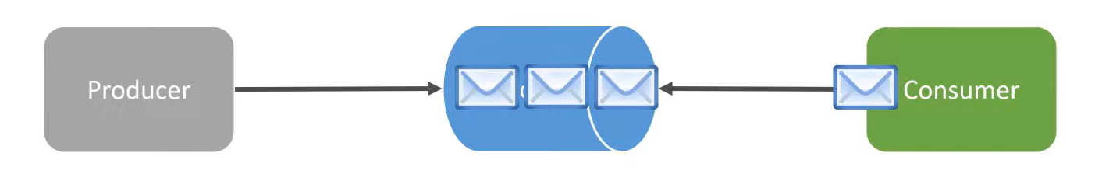
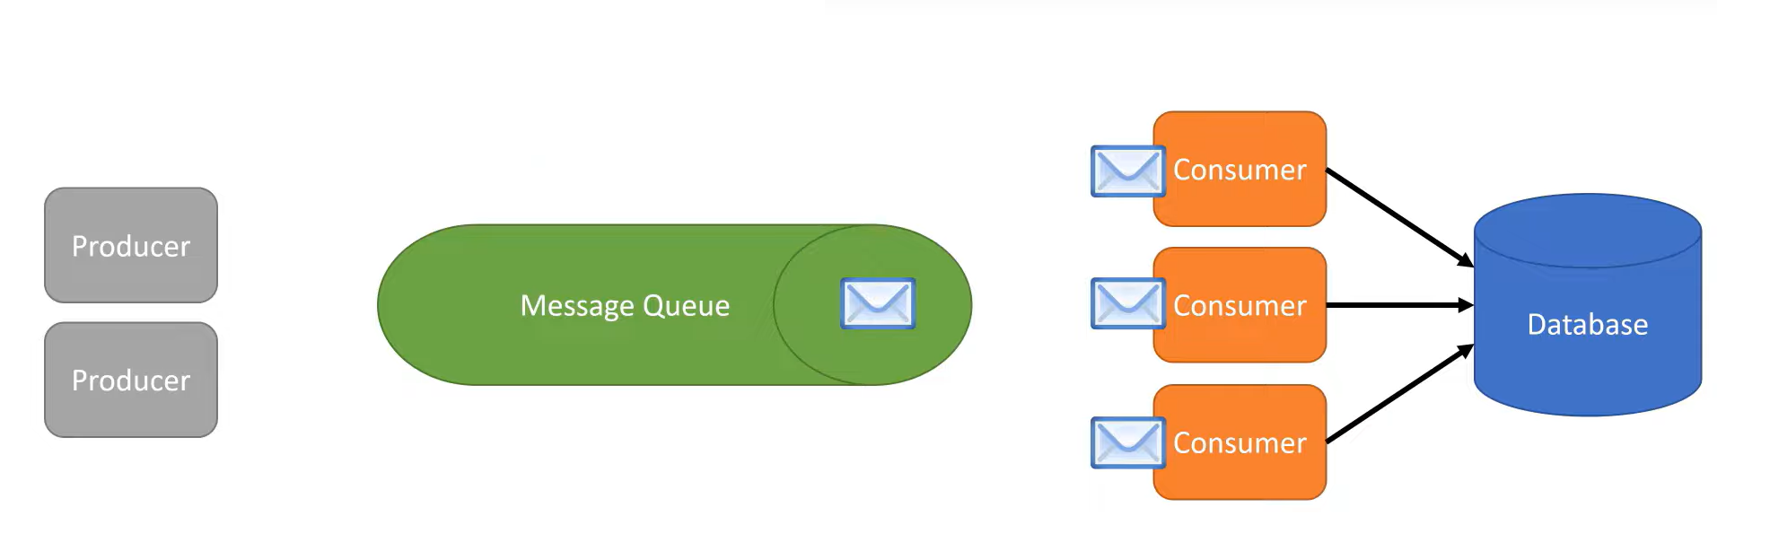
Competing Consumers pattern
Context and Problem –
Producer produces message at a rate which the consumer can’t process hence messages gets piled up in the queue. This is called Backpressure.
For e.g., Producer is producing 10000 messages/second and the consumer is only able to process messages at 2000 messages/second.
Solution –
Increasing the instances of the consumer.
Azure Functions in Consumption and Premium Plan scale in and out dynamically based on the load.
Azure Functions in Dedicated App Services plan can scale up and down (Manually) based on the CPU and memory utilization of the underlying App service plan.

Slide 46
Some issues with Azure Functions
Increased cold boot time (Consumption tier Azure functions)
Azure functions will timeout (Consumption tier: 5-10 minutes / Premium tier: 30-60 minutes), cannot perform long running operations.
Stateless (Can’t reference local files/assets)
If multiple functions are relying on each other using Output bindings, and if one of them fails its hard to notify the next function that the previous function errored out.

Slide 47
Durable Functions
Durable functions is an extension of Azure Functions.
It helps us to manage stateful long running workflows in Serverless environments.
It manages checkpoints and restarts the state from where it left off.
Based on the Durable Task Framework.
It can solve some of the difficult problems that can’t be solved by Azure Functions (See next slide)

Slide 48
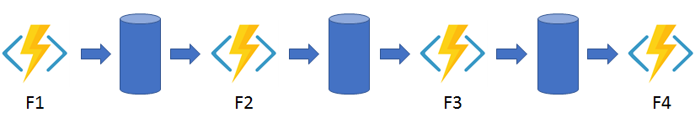
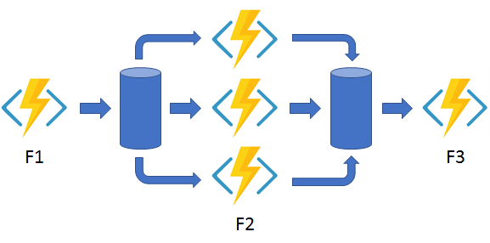
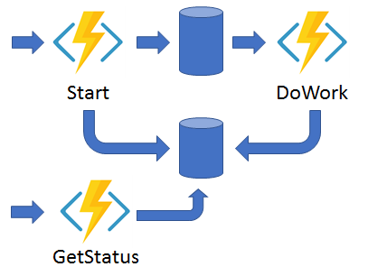
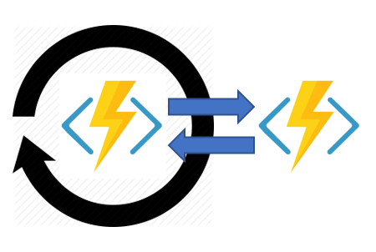
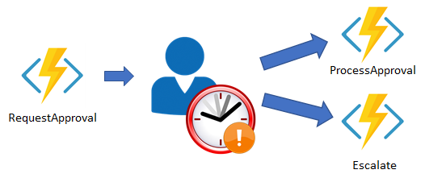
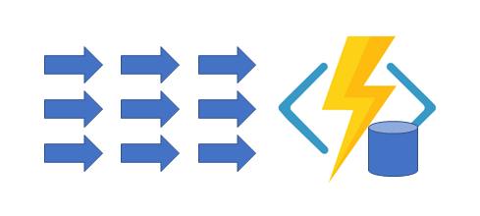
Pattern 1: Function Chaining
Pattern 2: Fan out
Pattern 3: Async HTTP API(s)
Pattern 4: Monitor
Pattern 5: Manual Approval
Pattern 6: Aggregator

Slide 49
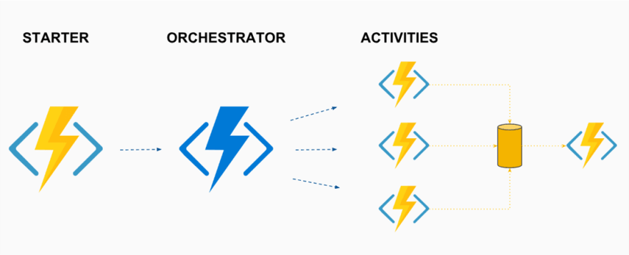
Main Components of Azure Durable Functions
Starter functions –
Entry point for creating durable functions orchestration.
Orchestrator functions –
It describes the order in which actions are executed. Actions must be deterministic.
Orchestrator functions sleep while current activity function is executing and wakes up when the next activity is about to run.
When orchestrator function sleeps that is not charged/billed.
Activity functions –
It is the basic atomic unit of work in durable function orchestration. Performs the unit of work.

Slide 50
Azure Durable Functions pattern demo

Slide 51
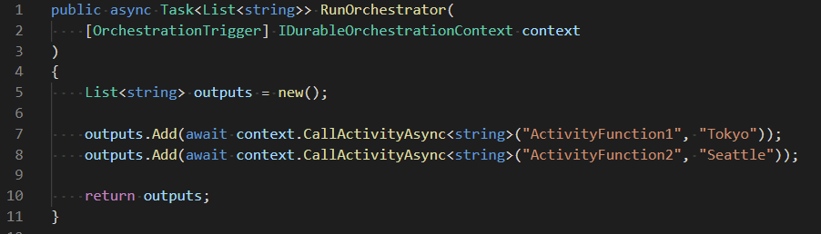
How Orchestrator Functions work internally?
Patterns used: Event Sourcing
It maintains each step of execution in History table in Azure Table Storage.
Orchestration started
Activity Function 1 scheduled
Orchestrator went to sleep
Orchestration started
Activity Function 1 completed
Orchestrator function called
Activity Function 2 scheduled
Orchestrator went to sleep
Activity function 1 called
Orchestration started
Activity Function 2 completed
Activity function 2 called
Orchestration execution completed

Slide 52
Orchestrator functions constraints
Must be deterministic. Use deterministic API(s) provided by Microsoft.
Avoid using Date and Time related API(s) – Instead use CurrentUtcDateTime provided in Durable functions context.
Avoid using Random numbers, GUID(s), Static variables, Infinite loops, etc.

